Slide 1

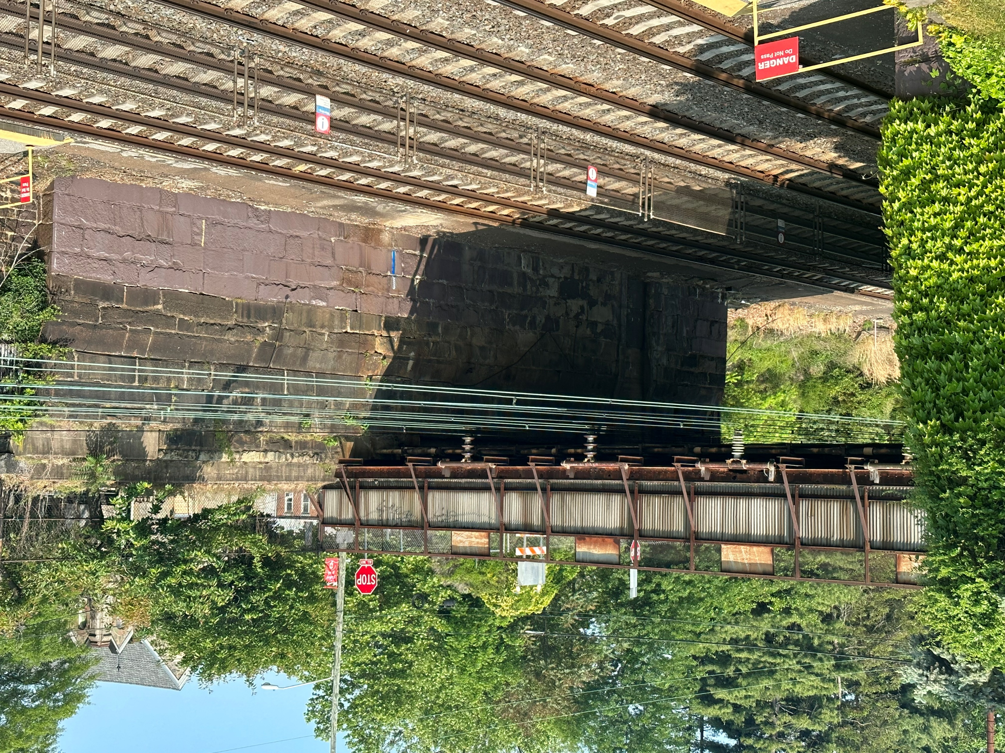
Sellers Ave. Bridge Replacement over AMTRAK
ECMS 15306
Ridley Park Borough, Delaware County
Notes:
TITLE SLIDE – SEE COMMENTS (go to the review tab and click on show comments)

Slide 2
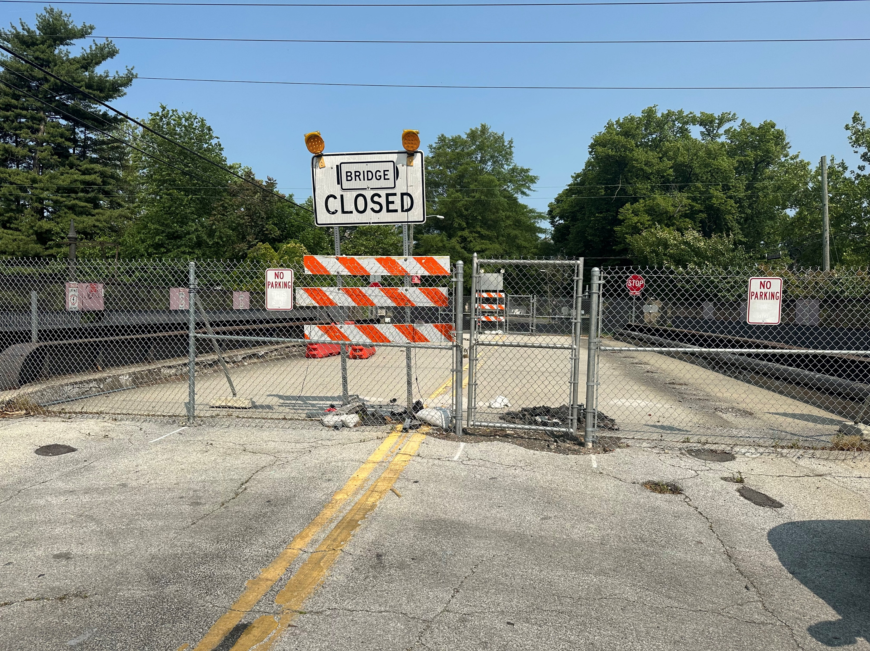
Closed July 20, 2022
Notes:
TITLE SLIDE – SEE COMMENTS (go to the review tab and click on show comments)

Slide 3
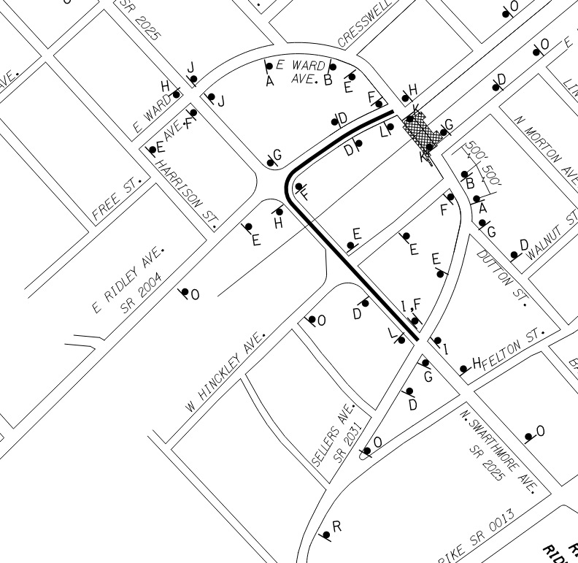
- Traffic will remain detoured over the Swarthmore Ave. Bridge for the duration of the Project
- Improved signage to be installed next month
Notes:
TITLE SLIDE – SEE COMMENTS (go to the review tab and click on show comments)

Slide 4
New Bridge/Project Design includes:
- (2) 12’ Vehicle Lanes
- (2) 8’ Sidewalks
- (6) Sidewalk Luminaires
- New water and communication lines
- Increased Load Rating (from 3T to 102T)
- Improved Fencing
- (11) ADA Ramps
- Improved Drainage
- Intersection Improvements (incl. signals)
- Full Depth Reconstruction of Ridley and Hinckley Aves.
Notes:
TITLE SLIDE – SEE COMMENTS (go to the review tab and click on show comments)

Slide 5
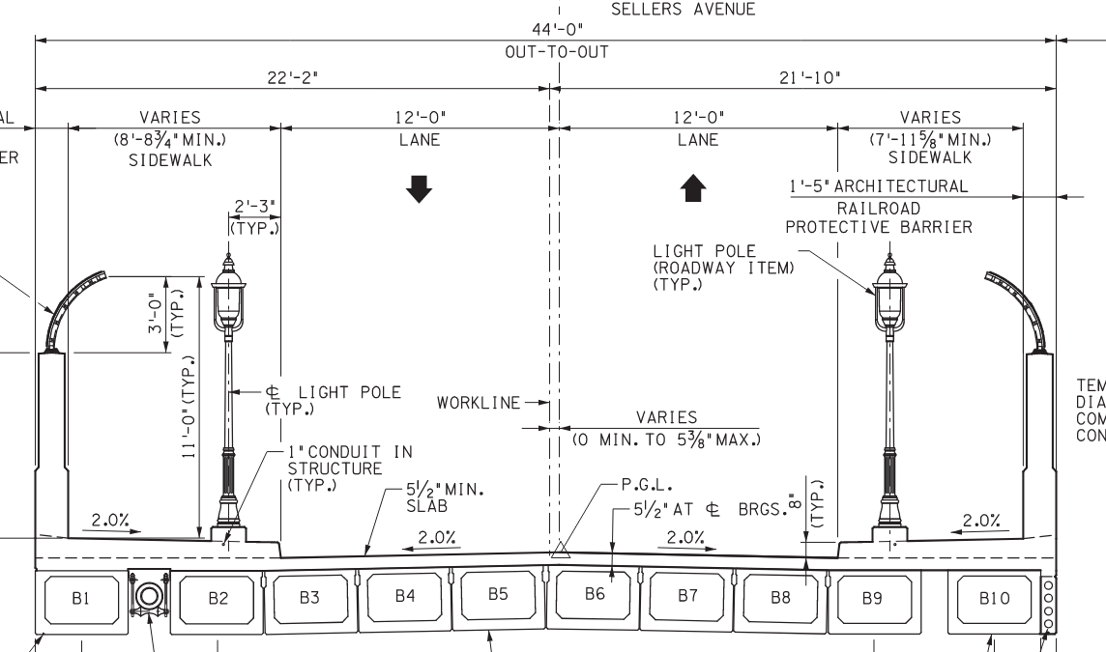
New Bridge
Notes:
TITLE SLIDE – SEE COMMENTS (go to the review tab and click on show comments)

Slide 6
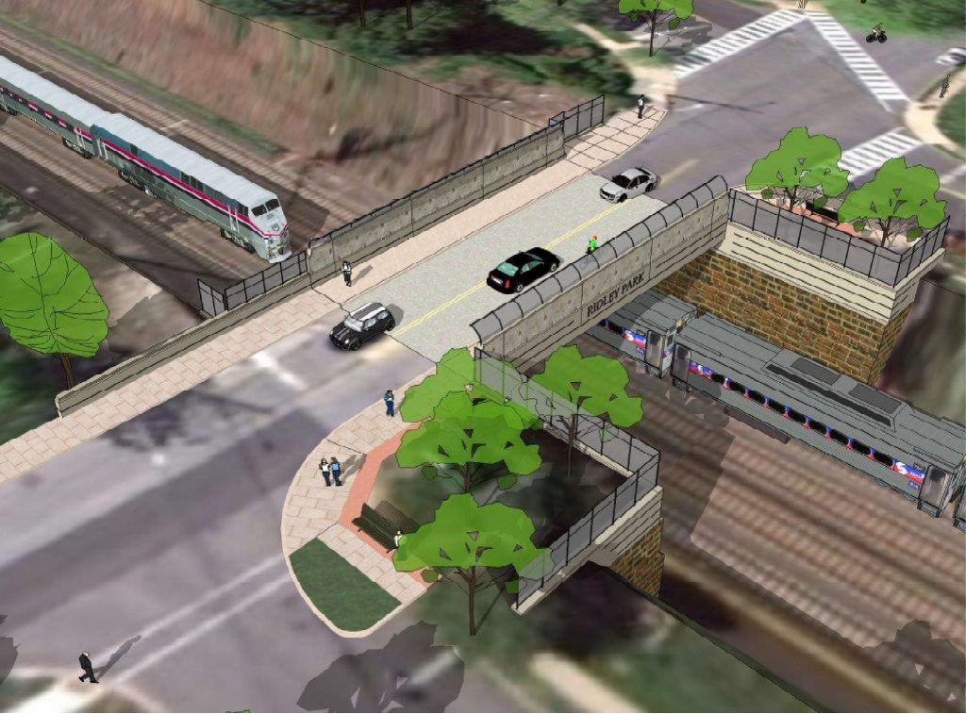
New Bridge
Notes:
TITLE SLIDE – SEE COMMENTS (go to the review tab and click on show comments)

Slide 7
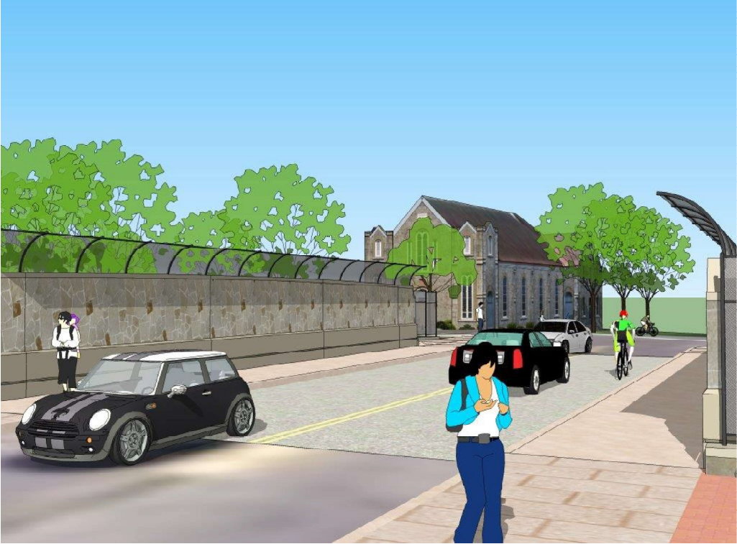
New Bridge
Notes:
TITLE SLIDE – SEE COMMENTS (go to the review tab and click on show comments)

Slide 8
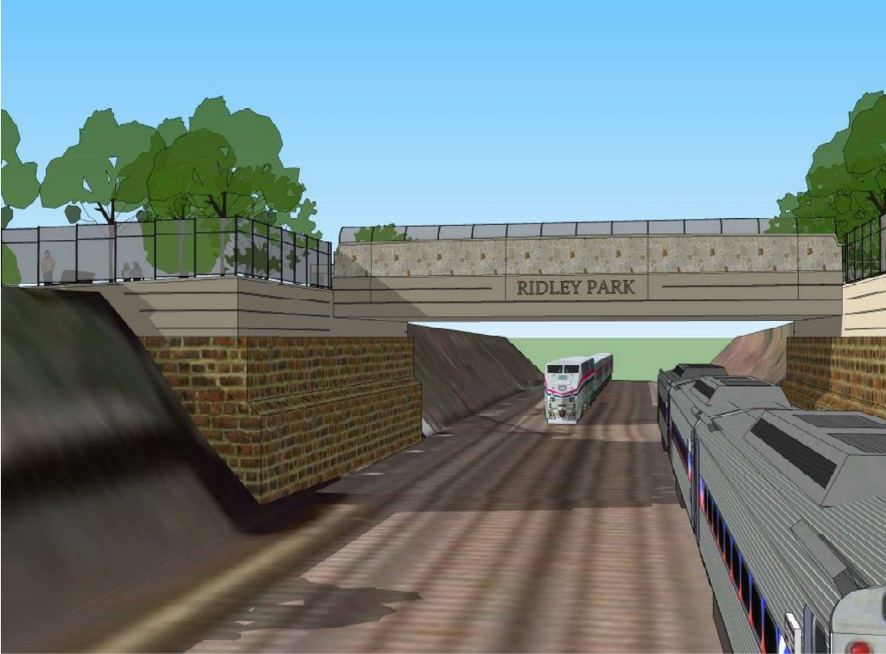
New Bridge
Notes:
TITLE SLIDE – SEE COMMENTS (go to the review tab and click on show comments)

Slide 9
Bid Results March 2, 2023
Road-Con, Inc. (low bidder) $ 9.8M
* Lowest of three bids
Notes:
TITLE SLIDE – SEE COMMENTS (go to the review tab and click on show comments)

Slide 10
Contract Awarded March 14, 2023
Notice to Proceed April 10,2023
Bridge Open July 1, 2026
Project Completion (planting season) June 30, 2027
Notes:
TITLE SLIDE – SEE COMMENTS (go to the review tab and click on show comments)

Slide 11
Funding
100% Federal
Minority Participation
10% or $980K
Trainees
1 Required
Wages Prevailing Rates
(certified payrolls and wage checks)
ADA Compliant 11 new ramps
Notes:
TITLE SLIDE – SEE COMMENTS (go to the review tab and click on show comments)

Slide 12
Notes:
TITLE SLIDE – SEE COMMENTS (go to the review tab and click on show comments)

Slide 13
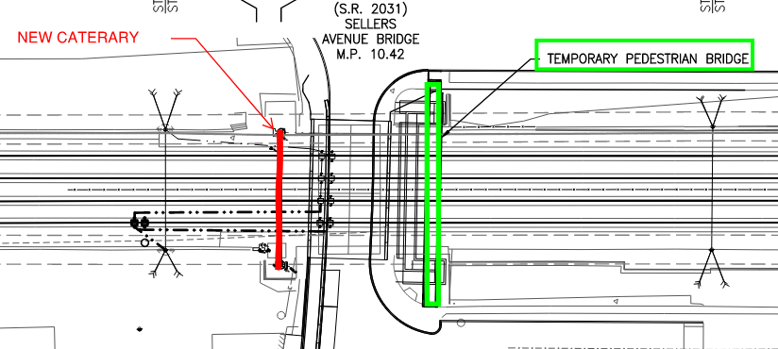
AMTRAK (2023)
Notes:
TITLE SLIDE – SEE COMMENTS (go to the review tab and click on show comments)

Slide 14
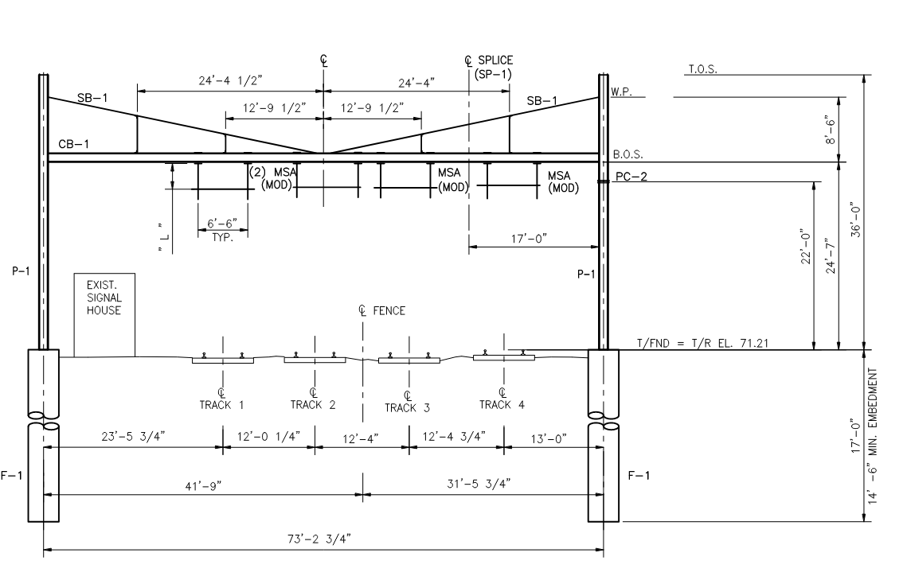
AMTRAK (2023)
- Shielding
- (2) 48” dia. Caissons 17’ deep
- Fabricate and Erect new catenary
- Install new AMTRAK power hardware
- Re-route power and remove old from bridge
Notes:
TITLE SLIDE – SEE COMMENTS (go to the review tab and click on show comments)

Slide 15
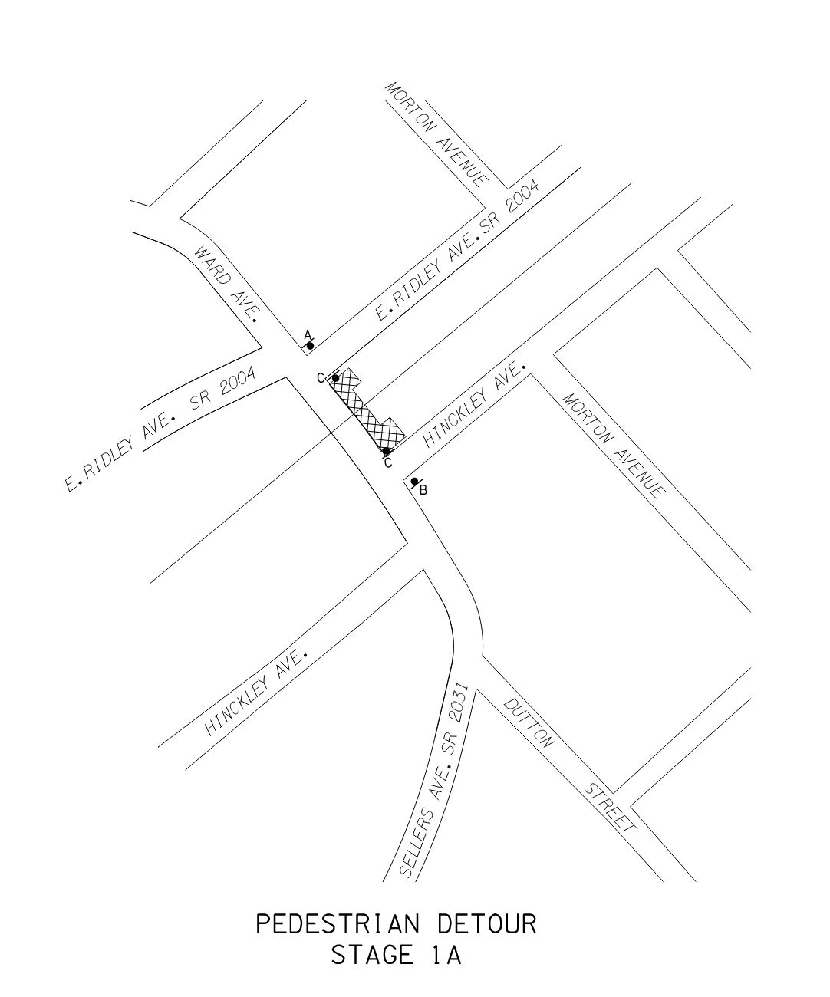
Stage 1A (1st Half 2024)
- Temporary Pedestrian Bridge
- Design by Contractor
- 5’ wide / 42” handrails / min 8’ high fencing
- Utilities to be temporarily relocated (Aqua and Verizon)
Notes:
TITLE SLIDE – SEE COMMENTS (go to the review tab and click on show comments)

Slide 16
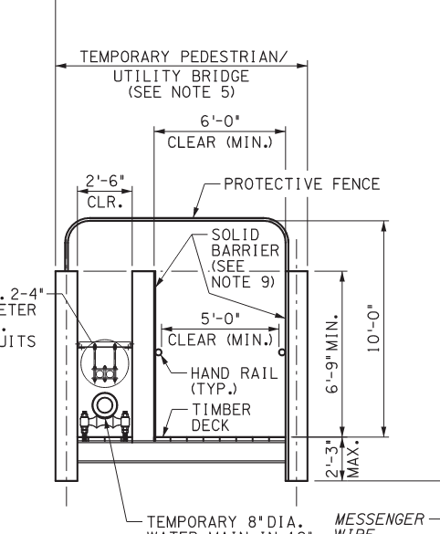
Temporary Pedestrian Bridge (ADA Compliant)
* Conceptual Only –
May be redesigned by Contactor
(design/build)
Notes:
TITLE SLIDE – SEE COMMENTS (go to the review tab and click on show comments)

Slide 17
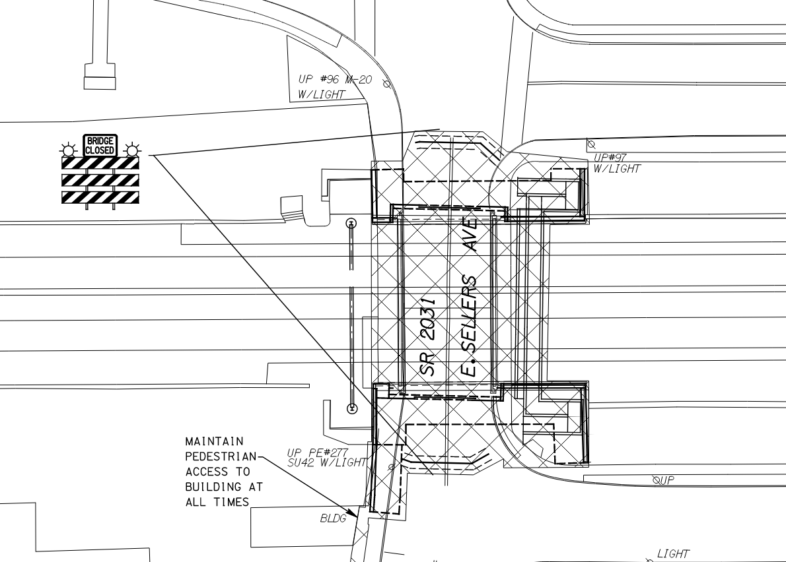
Stage 1B (2nd Half 2024)
- Temporary Shielding
- Temporary Shoring
- Demo (deck and beams)
- Utilities to be temporarily relocated (Aqua and Verizon)
Notes:
TITLE SLIDE – SEE COMMENTS (go to the review tab and click on show comments)

Slide 18
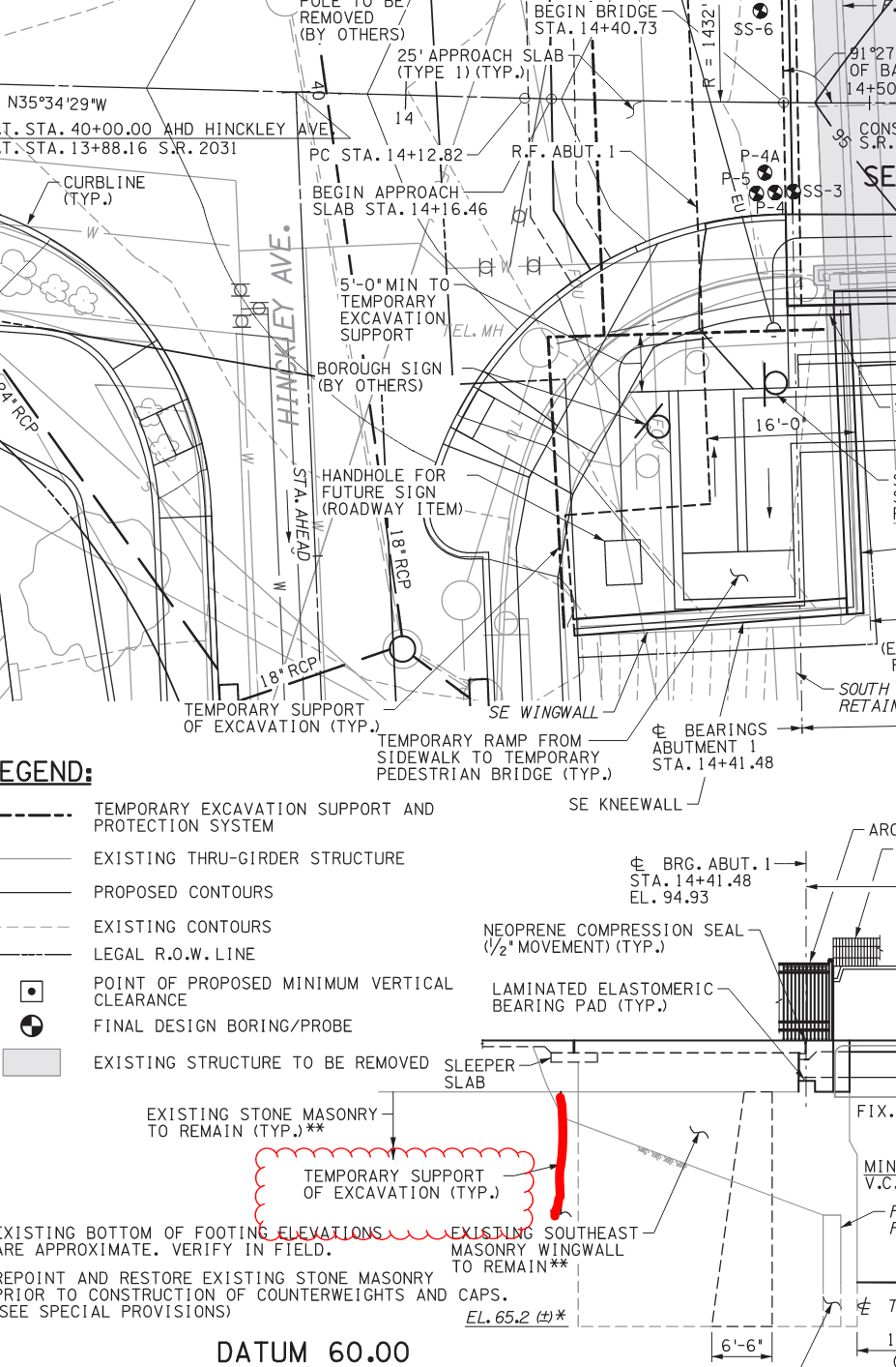
Stage 1B (2nd Half 2024)
- Temporary Shoring to be installed to keep Hinckley Ave. open
Notes:
TITLE SLIDE – SEE COMMENTS (go to the review tab and click on show comments)

Slide 19
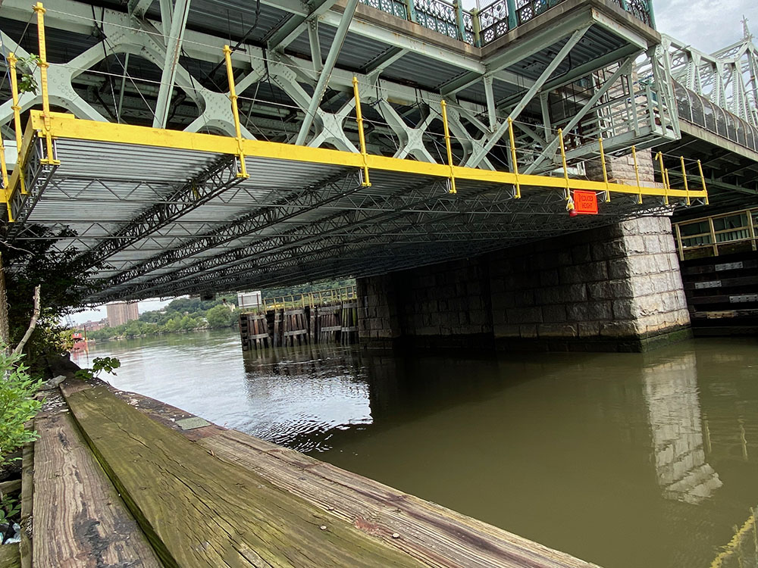
Stage 1B (2nd Half)
- Temporary Shielding to be installed to protect AMTRAK from falling debris
Notes:
TITLE SLIDE – SEE COMMENTS (go to the review tab and click on show comments)

Slide 20
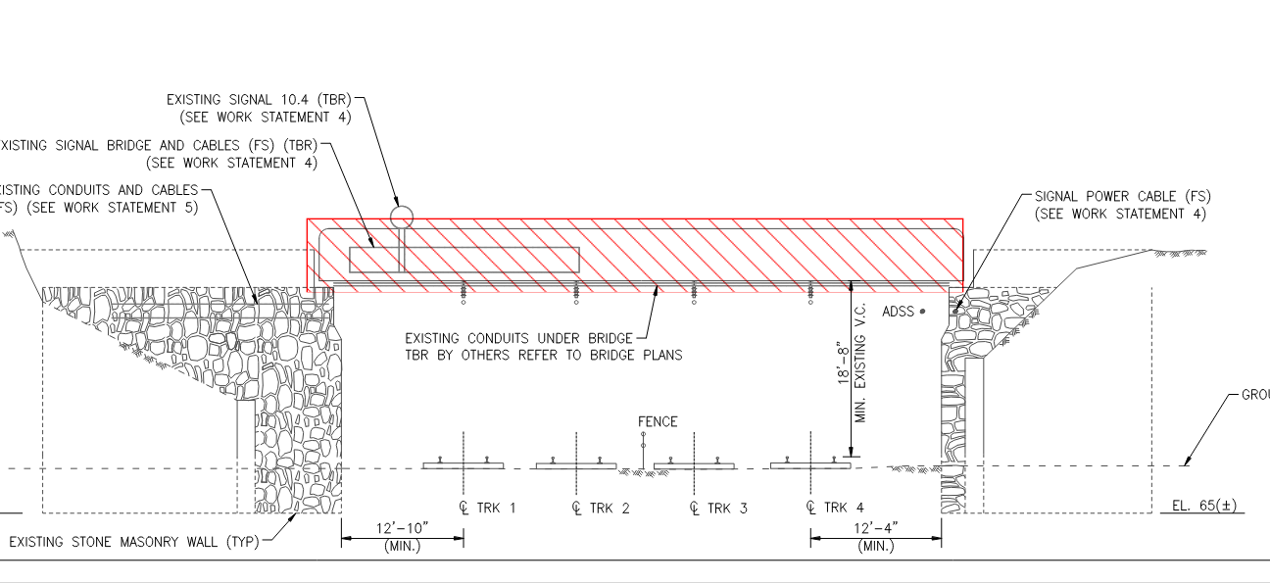
Stage 1B (2nd Half 2024)
- Demo
- Sawcut and remove deck, beams and backwall
Notes:
TITLE SLIDE – SEE COMMENTS (go to the review tab and click on show comments)

Slide 21
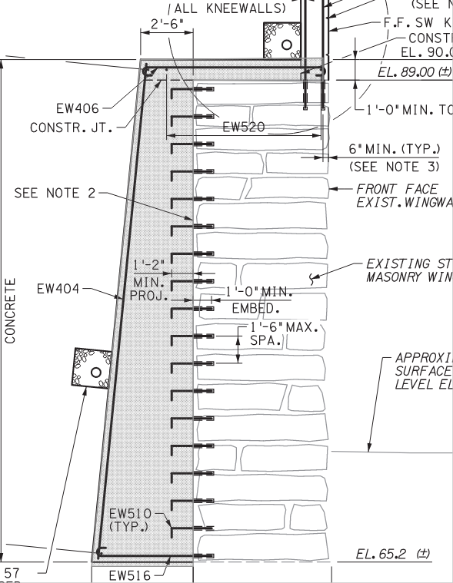
Stage 1B (2nd Half 2024)
Counterweight Walls and Pedestal
- Front Face of Existing Stone Wall to Remain
- Drill Dowels
- Form / Rebar / Pour Class A Concrete CW Wall
Notes:
TITLE SLIDE – SEE COMMENTS (go to the review tab and click on show comments)

Slide 22
Stage 1B (2nd Half 2024)
- Set (10) Pre-Cast Beams
- Installation of new 10” water line and communication lines
- Form / Rebar/ Pour Deck
- 14-day wet cure
- Form / Rebar / Pour Sidewalks
- Form / Rebar / Pour Barrier
- Install Luminaires and Fencing
- Approach Slabs and Sidewalks
Notes:
TITLE SLIDE – SEE COMMENTS (go to the review tab and click on show comments)

Slide 23
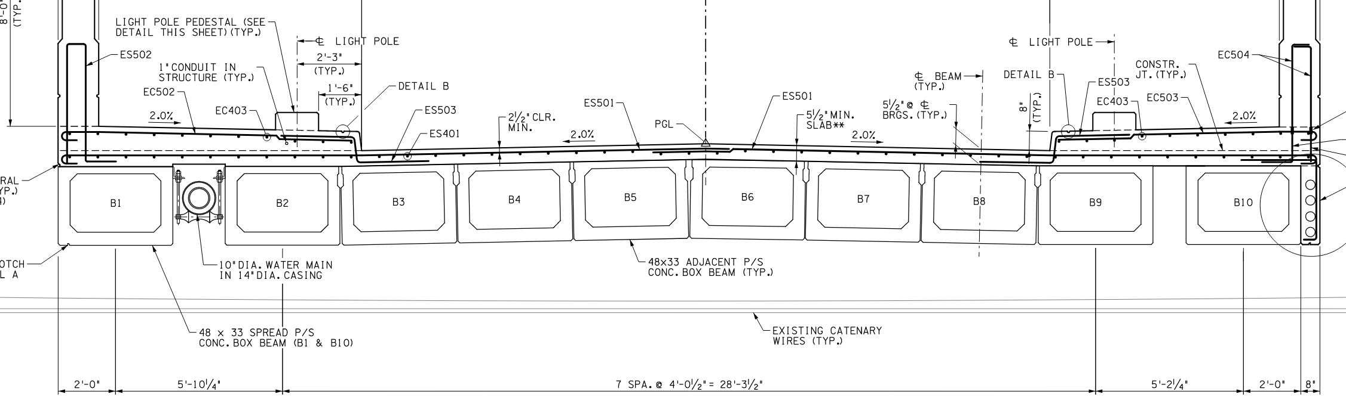
Stage 1B (2nd Half 2024)
Set Pre-Cast Beams
Includes the installation of new 10” water line and communication lines
Notes:
TITLE SLIDE – SEE COMMENTS (go to the review tab and click on show comments)

Slide 24
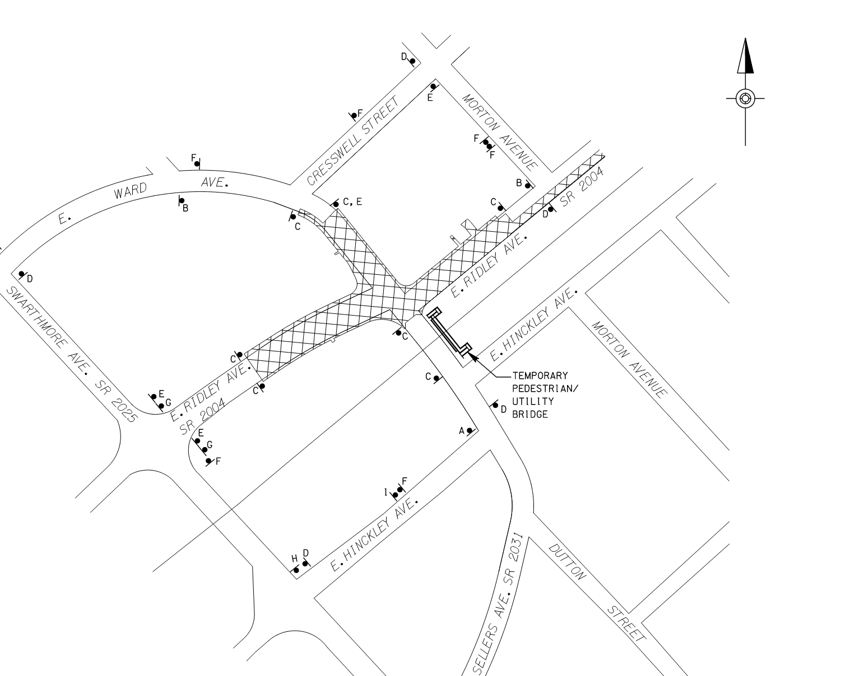
Stage 2 (2025)
Notes:
TITLE SLIDE – SEE COMMENTS (go to the review tab and click on show comments)

Slide 25
Stage 2 (2025)
- Closes Traffic on E. Ridley Ave. between Swarthmore Ave. and Thayer Ave.
- Closes Traffic on E. Ward Ave between and Cresswell St. and the Bridge
- All Residential Access must be Maintained by the Contractor
Notes:
TITLE SLIDE – SEE COMMENTS (go to the review tab and click on show comments)

Slide 26
Stage 2 (2025)
- Utilities - Relocate Gas and Water
- Signal Improvement at Swarthmore and Ridley Ave
- Drainage Improvements
- Curb, Sidewalk and ADA Ramps
- Full Depth Reconstruction
- Landscape Improvements
Notes:
TITLE SLIDE – SEE COMMENTS (go to the review tab and click on show comments)

Slide 27
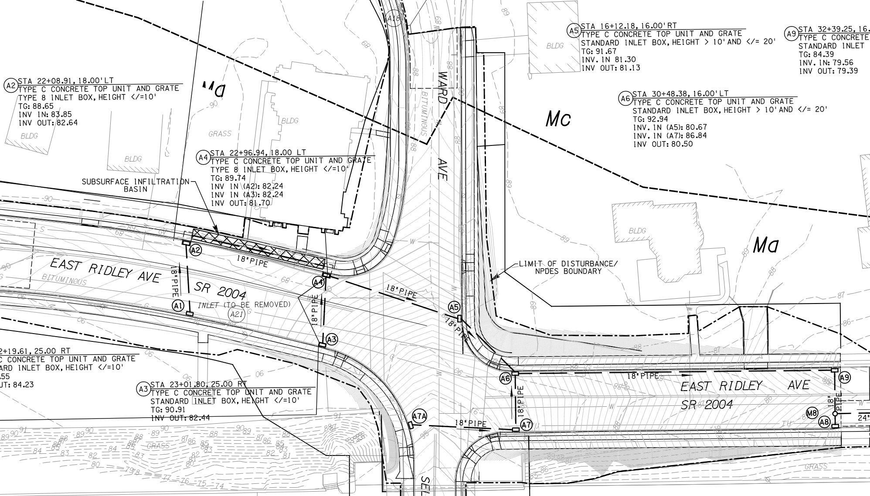
Stage 2 (2025)
- Utilities - Relocate Gas and Water
-
Notes:
TITLE SLIDE – SEE COMMENTS (go to the review tab and click on show comments)

Slide 28
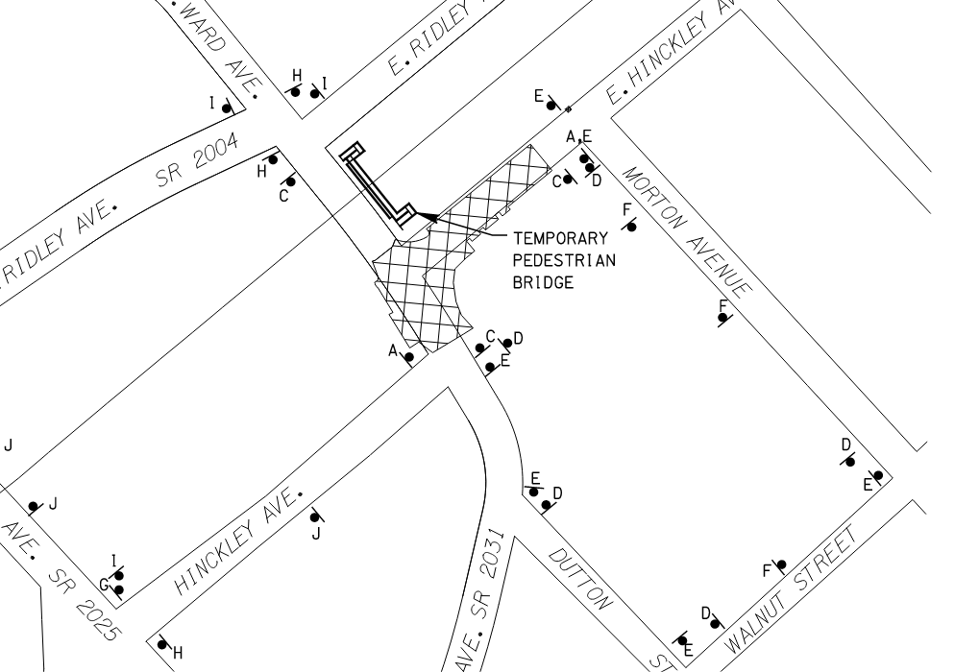
Stage 3A (1st Quarter 2026)
Notes:
TITLE SLIDE – SEE COMMENTS (go to the review tab and click on show comments)

Slide 29
Stage 3A (1st Quarter of 2026)
- Closes Traffic on Hinckley Ave. from Morton Ave. west
- Closes Traffic on Sellers Ave between and Hinckley Ave. and the Bridge
- All Residential Access must be Maintained by the Contractor
Notes:
TITLE SLIDE – SEE COMMENTS (go to the review tab and click on show comments)

Slide 30
Stage 3A (1st Quarter of 2026)
- Utilities - Relocate Gas
- Drainage Improvements
- Signal Improvements at Sellers Ave. and Swarthmore Ave.
- Curb, Sidewalk, Pavers and ADA Ramps
- Full Depth Reconstruction
- Landscape Improvements
Notes:
TITLE SLIDE – SEE COMMENTS (go to the review tab and click on show comments)

Slide 31
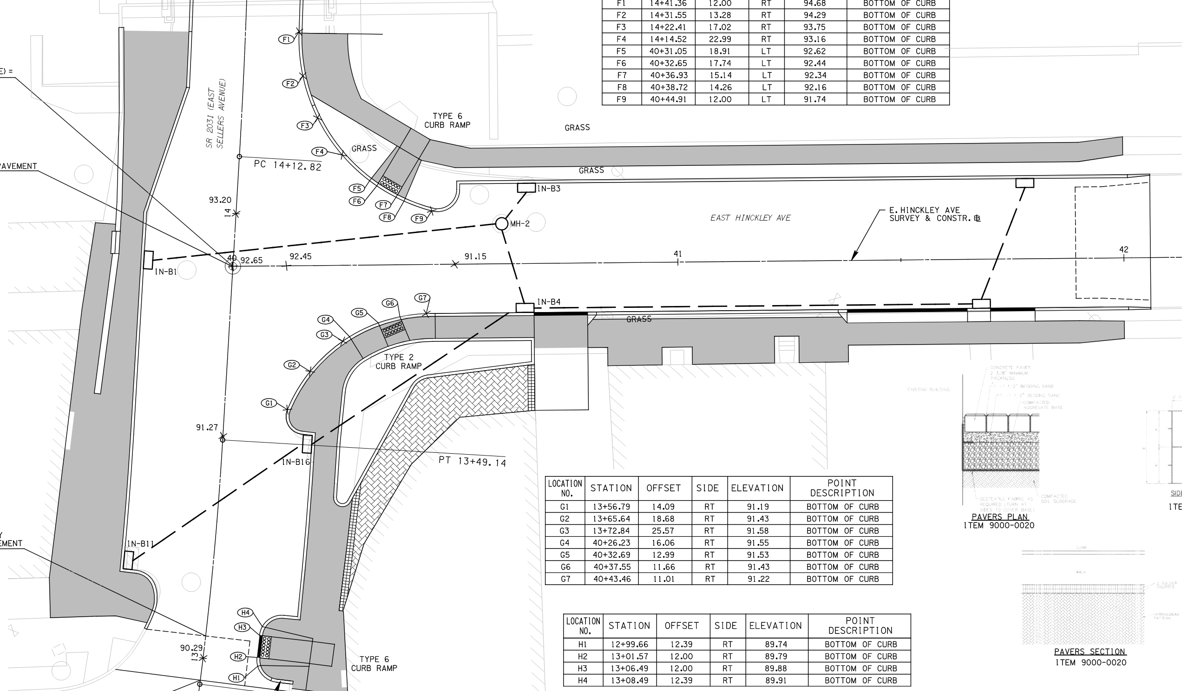
Stage 3A (1st Quarter of 2026)
-
Notes:
TITLE SLIDE – SEE COMMENTS (go to the review tab and click on show comments)

Slide 32
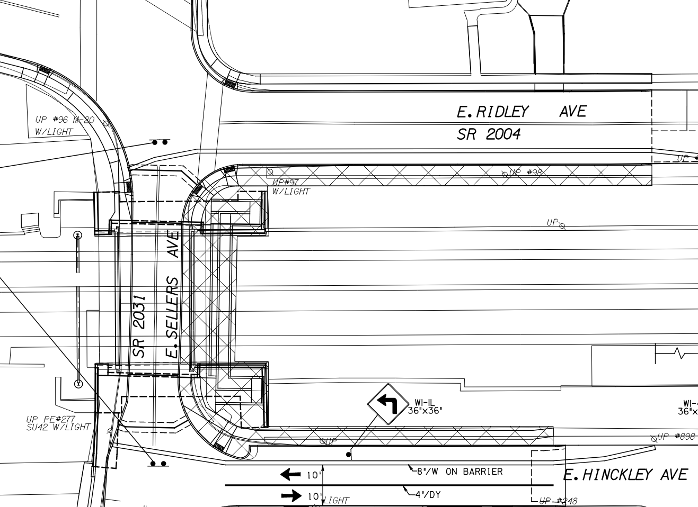
Stage 3B (2nd Quarter of 2026)
Notes:
TITLE SLIDE – SEE COMMENTS (go to the review tab and click on show comments)

Slide 33
Stage 3B (2nd Quarter of 2026)
- Closes Traffic the eastbound shoulder E. Ridley Ave.
- Closes Traffic the westbound shoulder E. Hinkley Ave.
- All Residential Access must be Maintained by the Contractor
Notes:
TITLE SLIDE – SEE COMMENTS (go to the review tab and click on show comments)

Slide 34
Stage 3B (2nd Quarter of 2026)
- Remove Temp. Bridge
- Form/Rebar/Pour kneewalls and barrier for Bridge – Tie-In Piece
- Install bridge fencing
- Final sidewalk and landscaping
ANTICIPATED OPEN BRIDGE ON JULY 1, 2026
Notes:
TITLE SLIDE – SEE COMMENTS (go to the review tab and click on show comments)

